Slide 1
Mobile App for Public Safety
IT 691 – Capstone project
Dayanand Dyawarashetty
Karishma Saini
Jorgelina Alba
Danny Squicciarini
Dr. Charles C. Tappert
Dr. Avery M. Leid
May 7th, 2020

Slide 2
Public Safety MOBILE APP
This APP service is enabling people to share intelligence about daily nearby incidents in the city which required immediate medical assistance.
By sharing the nearby critical incident experiences may help others safety and also connect with fellow peoples and enhance public services.
As this system capture the nearby reported incidents and provide notification to first responder & professional users based on their location. So, it helps to stimulate communication, cooperation, reciprocity and social cohesion between all users in order to make the app useful.
Here professional user’s are certified off-duty professionals as well as first responders who are within the area of the patient and can expediently provide lifesaving measures before emergency medical responders arrive. The secondary goal of this application will be to provide first responders with a more accurate location of the patient in need by utilizing Global Positioning System technology
PRIVACY APP LINK :- https://public-unity-safety.flycricket.io/privacy.html
Code shared at :- https://github.com/PACE-University-CapstoneProjects/TEAM10--CS691-692-IT691-SPRING-2020

Slide 3
Public Safety MOBILE APP
Flutter :- Flutter is Google’s mobile app SDK which have complete features with a framework, widgets, and tools. Its easy to build and deploy fast and also development can done on both Android and iOS platforms simultaneously.
User Authentication :- Flutter provide Authentication libraries as a common task put on mobile apps.
Dart language :- Dart is Google’s modern programming language since 2011.Its intermediate with Object Oriented
Programming and Generics.
FireBase :- To setup and store CRUD Operations.
GeoLocator/Geolocation Plugin :- This Flutter geolocation plugins helpful to track specific location of provide
notifications on nearby incidents.

Slide 4
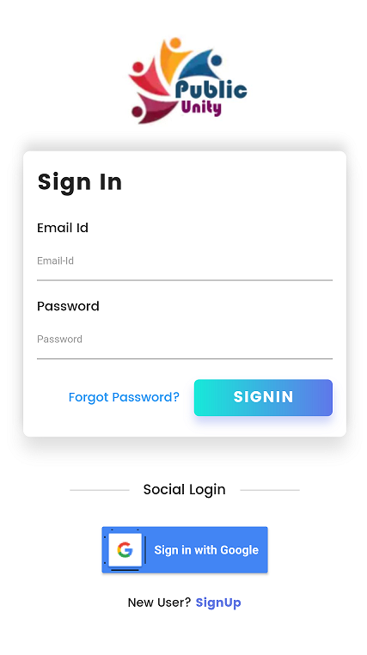
SIGN IN Page
OPTION TO SIGN IN with email-id or google sign-in

Slide 5
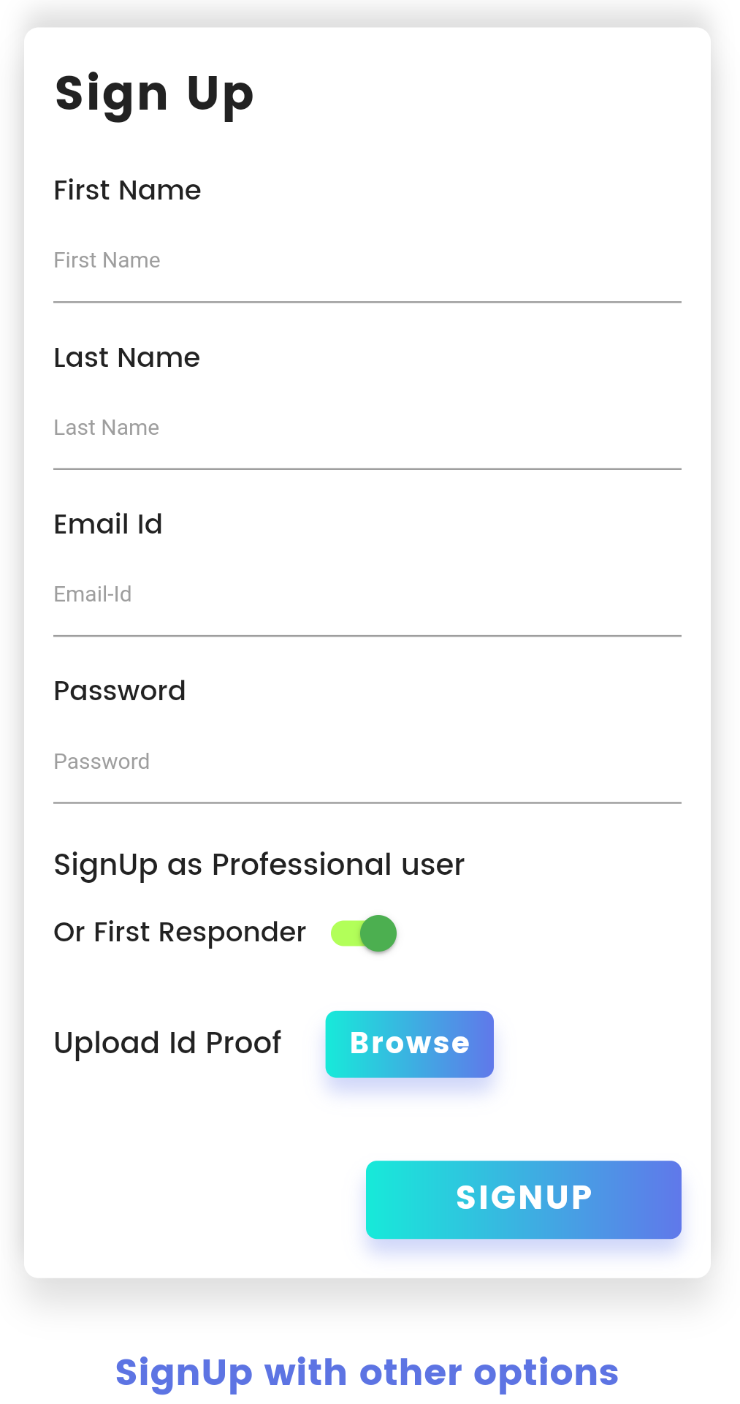
SigN Up
Option to SIGN UP as First Responder/Professional or Civil User

Slide 6


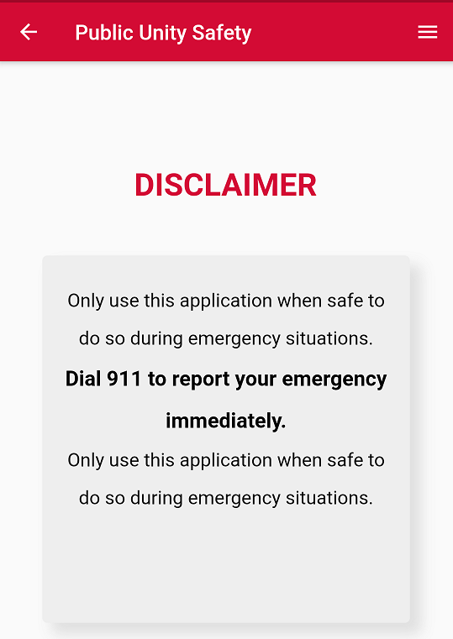
DISCLAIMER PAGE
To make sure this app is not for emergency

Slide 7
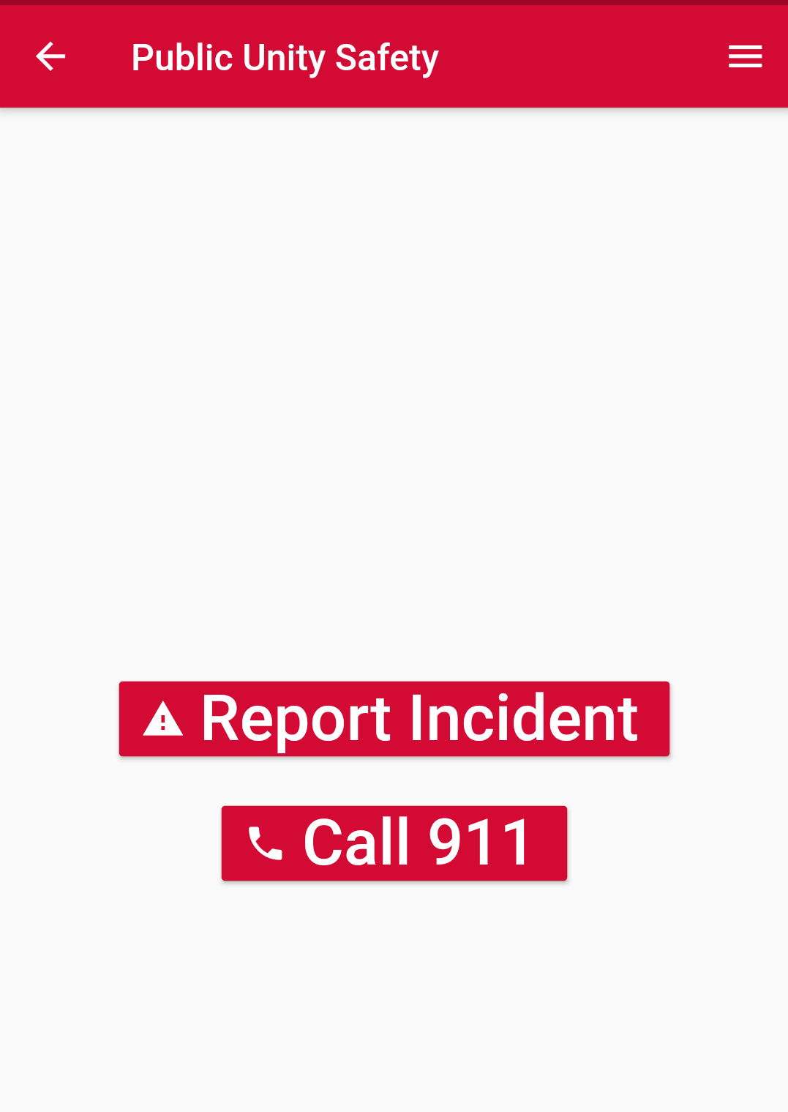
LANDING PAGE of CIVIL USER

Slide 8
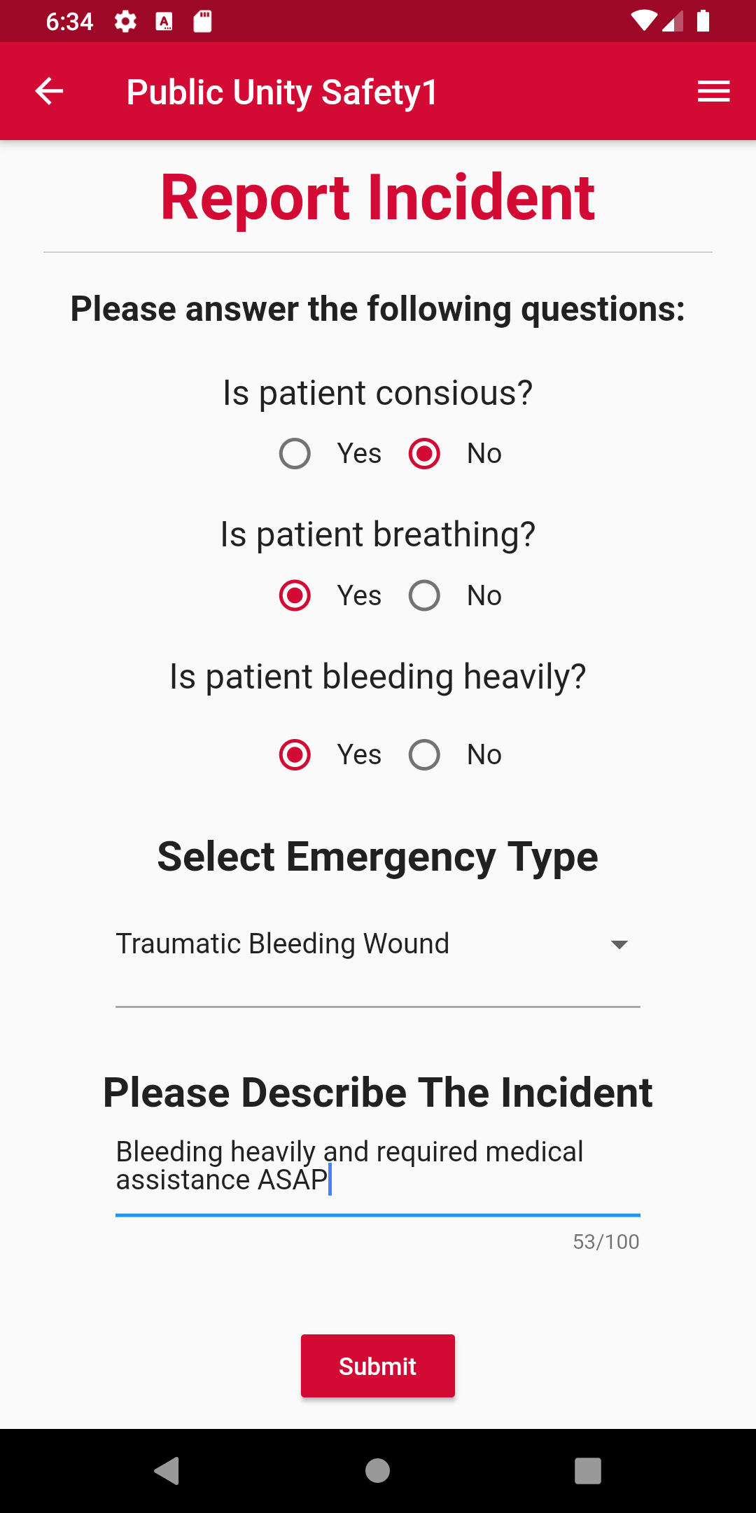
REPORT AN INCIDENT

Slide 9
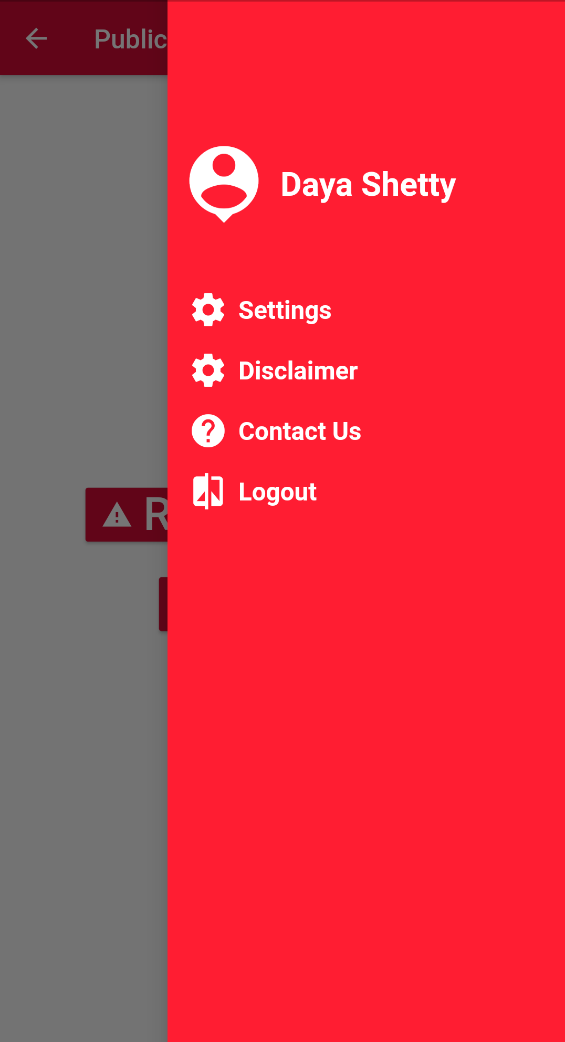
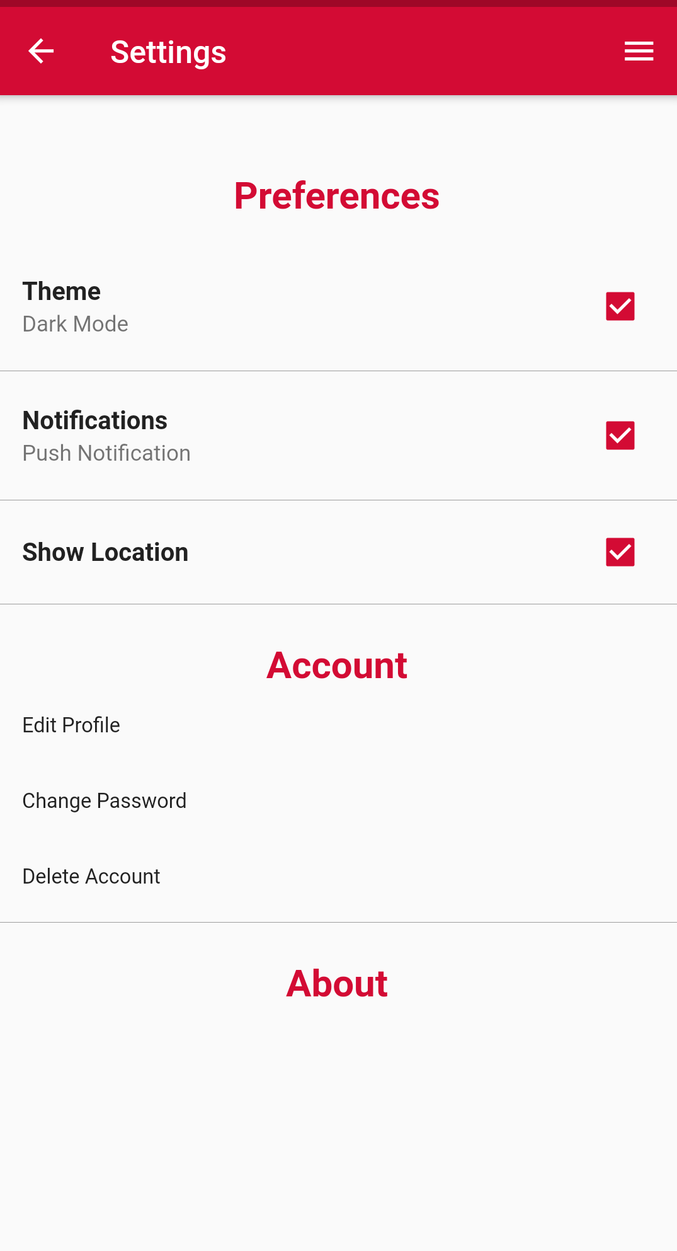
SETTING PAGE

Slide 10
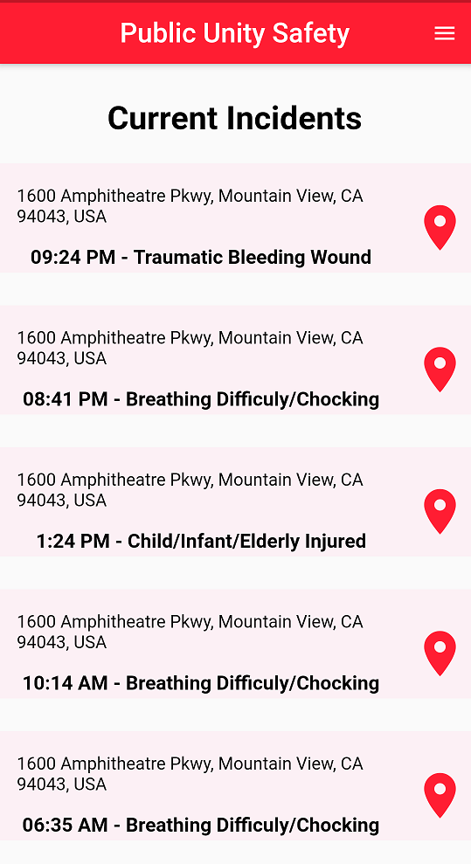
FIRST RESPONDER LANDING PAGE

Slide 11
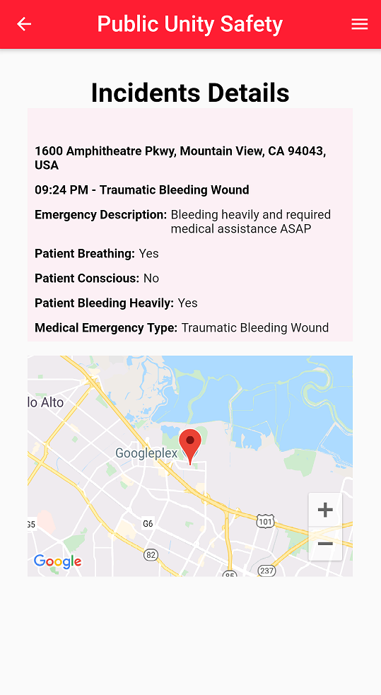
FIRST RESPONDER Incident details
Here, First responder can see full details of particular reported incident details. Option to easily navigate to the incident location

Slide 12
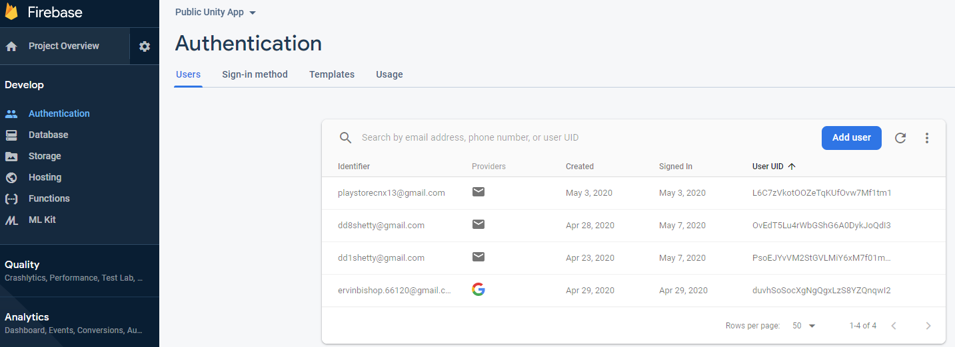
FIREBASE AUTHENTICAION

Slide 13
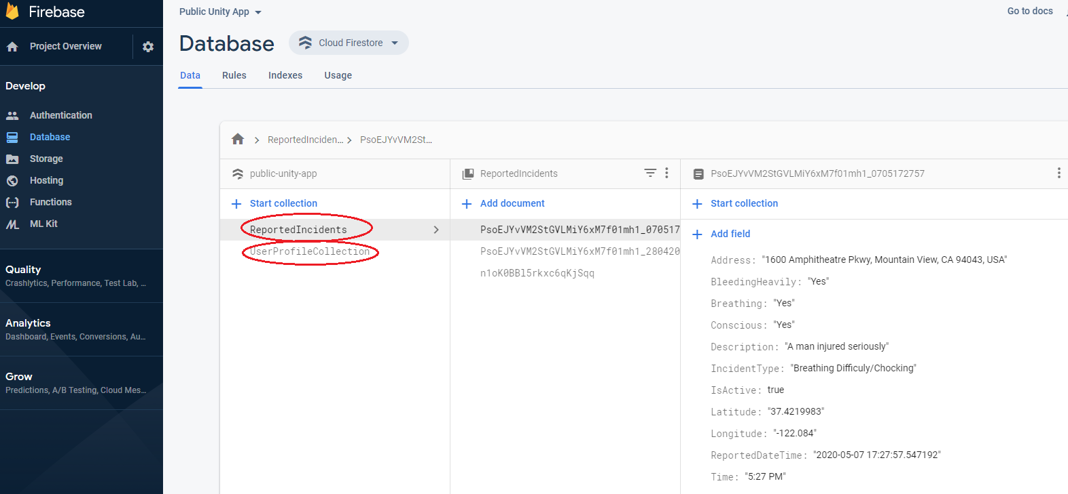
FIREBASE DATABASE
Registered user Collection
& Reported Incident details

Slide 14
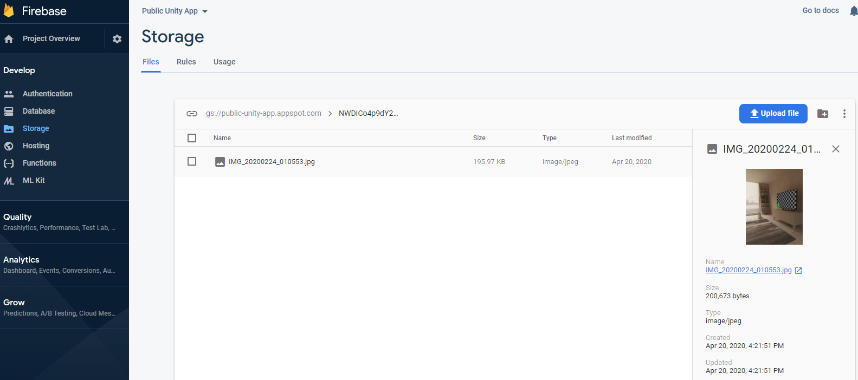
FIREBASE STorage
Id Proof validation provided by First Responder/Civil User

Slide 15
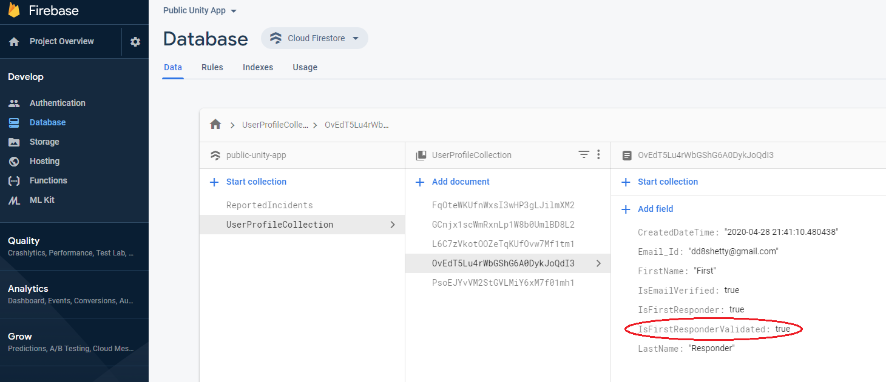
FIREBASE STorage
First Responder/Civil User are set to login only after IsFirstResponderValidated set to TRUE

Slide 16
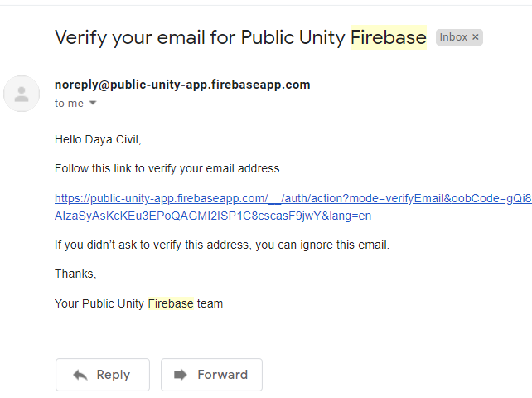
Verify Email after registration to our app

Slide 17
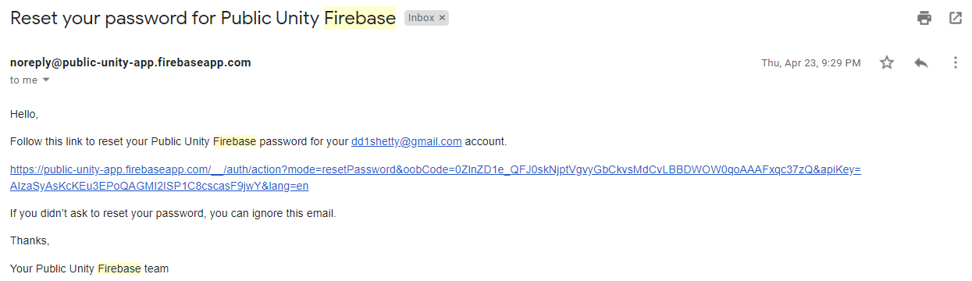
RESET PASSWORD

Slide 18
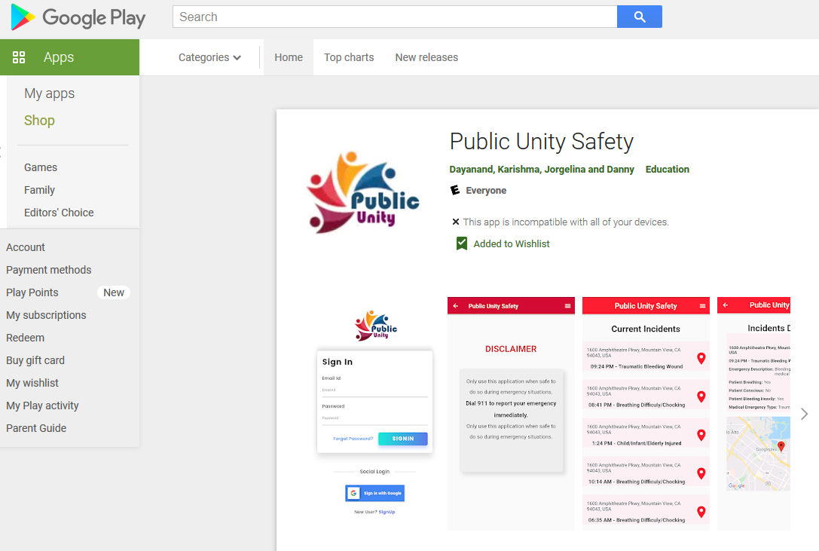
APP PUBLISHED TO GOOGLE PLAY STORE

Slide 19
Thank You

Slide 20
ANY questions?

